Slide 1

Hexaware CODE&RISE
InnovateX_Crescent's RideShare
InnovateX_Crescent presents their innovative RideShare application - a seamless, user-friendly platform for efficient, cost-effective, and environmentally responsible ride-sharing. This solution connects users for carpooling, reducing commuting costs and traffic congestion while contributing to sustainable mobility.
TM
by Tanush M M

Slide 2
Team and Application Overview
Team Name
Application Name
InnovateX_Crescent
Rideshare Application
Team Members
Email
Tanush M M
tanushmmofficial@gmail.com
Sirasudeen P
sirasudeenp@gmail.com
Syed Fayaadh S [Inactive]
fayaadhsyed@gmail.com
Gouri Shankar Prusty P [Inactive]
pgourishankarprusty@gmail.com

Slide 3

Introducing the RideShare Solution
1
Seamless User Experience
2
Financial Savings
The RideShare app provides a streamlined and intuitive interface for users to easily connect and coordinate their rides.
By facilitating carpooling, the app helps users save on commuting costs and reduces the individual burden of vehicle ownership.
3
Environmental Sustainability
4
Social Connectivity
The app fosters a sense of community by enabling users to connect and travel together, enhancing social interactions.
The RideShare solution promotes eco-friendly mobility by reducing traffic congestion and emissions through shared rides.

Slide 4

Solution Highlights and Key Features
Intelligent Ride Matching
Fair Pricing Model
The app utilizes advanced algorithms to intelligently match users with compatible ride-sharing partners based on their preferences and travel patterns.
The dynamic pricing model ensures fair and transparent cost allocation, considering factors like distance, time, and occupancy.
Enhanced Safety Features
Eco-Friendly Initiatives
The RideShare app incorporates security measures like user verification, real-time tracking, and emergency response protocols to prioritize the safety of all participants.
The solution promotes sustainable mobility by encouraging the use of fuel-efficient and low-emission vehicles, contributing to a greener commuting ecosystem.

Slide 5

Innovation and Creativity
1
Smart & Intelligent Ride Matching
The RideShare app leverages advanced algorithms and AI-powered matching to seamlessly connect users with compatible ride partners, optimizing for factors like location, schedule, and preferences.
2
Dynamic Pricing
The solution's dynamic pricing model adjusts rates based on real-time factors, ensuring fairness and transparency for both drivers and passengers.
3
Generative AI Integration
The app integrates cutting-edge generative AI technologies to enhance user experience, streamline operations, and continuously improve the platform's capabilities.

Slide 6

Architectural Approach
Frontend
React, Material UI, Google Maps API
Backend
Python (Flask), Express.js, JWT, bcrypt
Database
MongoDB
DevOps
Git, GitHub, Docker, AWS (EC2, S3)
Security
JWT, Hashing (bcrypt)
Testing
Postman

Slide 7
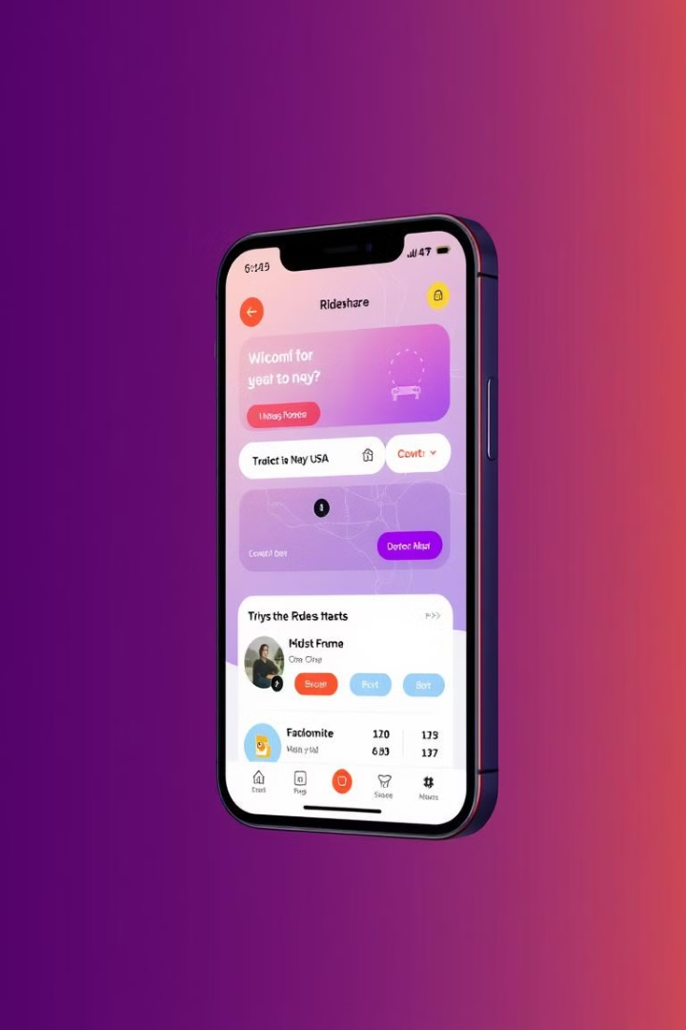



User-Centric Design
Request Ride
Users can easily request a ride based on their location and destination.
Match Rider
The app intelligently matches the user with compatible ride-sharing partners.
Complete Trip
Users can track their ride and provide feedback to improve the experience.

Slide 8
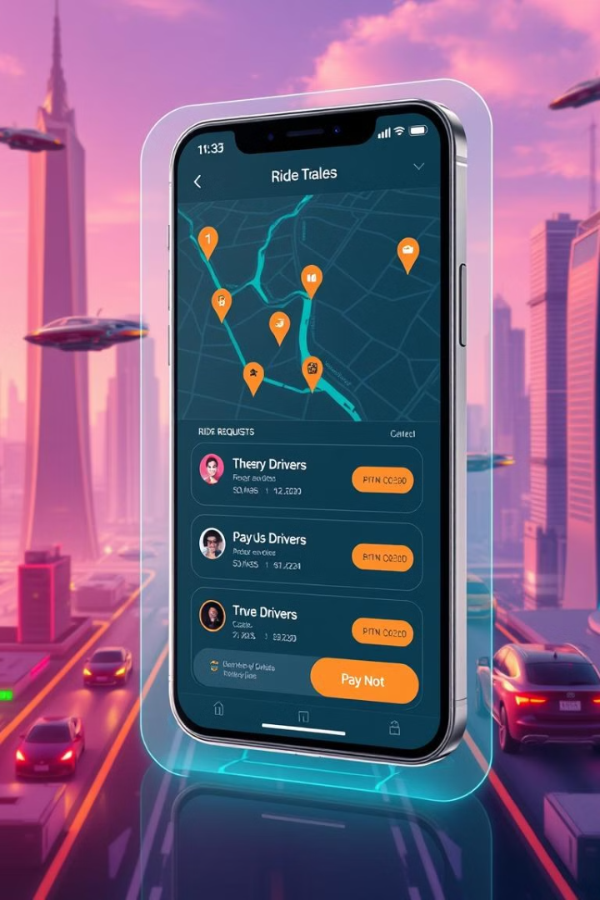
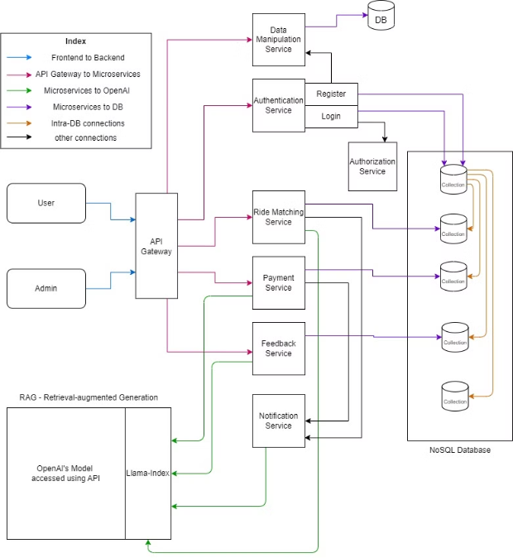
Technical Architecture
The RideShare solution uses a modern tech stack, including Python, Express.js, React, and Material UI. It integrates with Google Maps to provide a scalable, reliable, and high-performing ride-sharing platform.

Slide 9

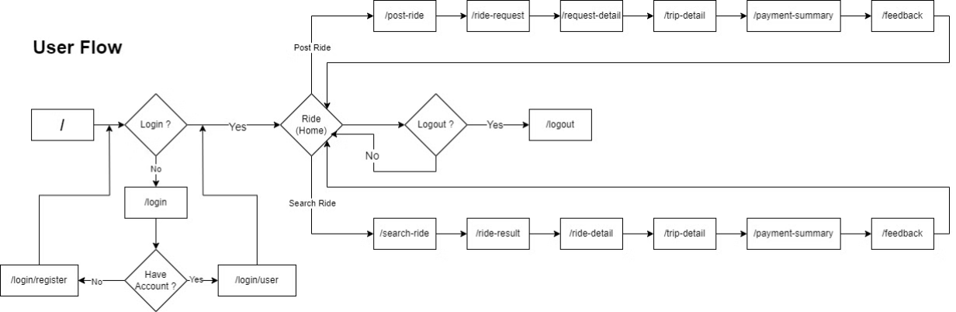
Functional Architecture - User Flow
The RideShare app's architecture supports user and admin needs. Users can request rides, match partners, and track trips. Admins can manage the platform, monitor performance, and ensure smooth operations.

Slide 10

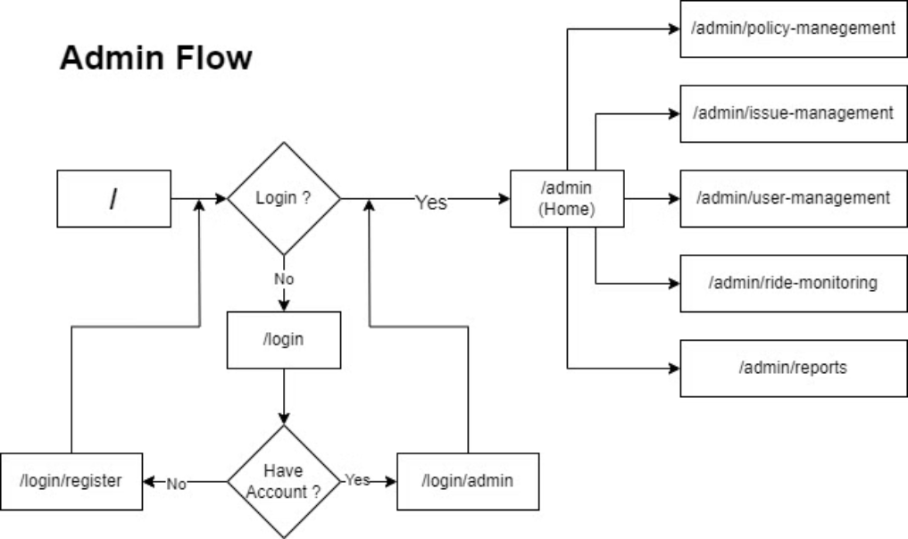
Functional Architecture - Admin Flow
The RideShare admin interface empowers platform oversight. Admins can monitor metrics, troubleshoot issues, and ensure reliable operations. They have tools to manage users, drivers, and fleet records to maintain the ecosystem.

